Slide 1
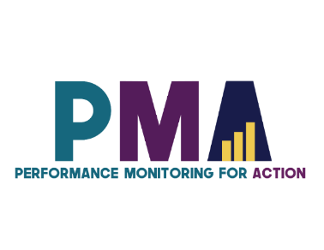
www.pmadata.org/stlr
We invite you to use and adapt PMA STLR tools!
Whatever tool you discover and intend to try out, you will need to adapt these tools to
your context. This may include:
Changing questionnaire question text: Some tools contain questions from our questionnaires (publicly available here), along with their numbering. Note that, in some cases, question numbering has changed across phases, but any questions cited in a tool use consistent numbering within that tool.
Considering appropriate pronouns: We use female pronouns quite often, as PMA worked with female enumerators – and as a bonus, we are happy to use a feminine pronoun by default for a change!
TIP: Use our hashtag system!
As we used these tools across various country contexts, we developed a simple system of using hashtags as placeholders for information that will need to be updated based on the country, context, culture, and program.
For example, information in a tool that was country-specific is noted with the hashtag placeholder, #countryspecific – or possibly an even more specific placeholder like #districtlevel or #localpartner.
Information that required a change in date is noted with hashtags such as #todaysdate or #lastyear.
These hashtags allow those adapting the tool to use the Find&Replace function to quickly identify and update all instances of a hashtag within seconds.

Slide 2
Introduction to Phone Interviewing
This presentation introduces the basics of conducting a phone interview, highlights key differences between face-to-face and phone interviews, and offers guidance on how to conduct an effective phone interview.
When adopting, adapting, and sharing this tool, please use this suggested citation:
“Introduction to phone interviewing”, created by PMA (Performance Monitoring for Action) with Sarah Nehrling. Released June 2024. CC BY-NC 4.0.

Slide 3
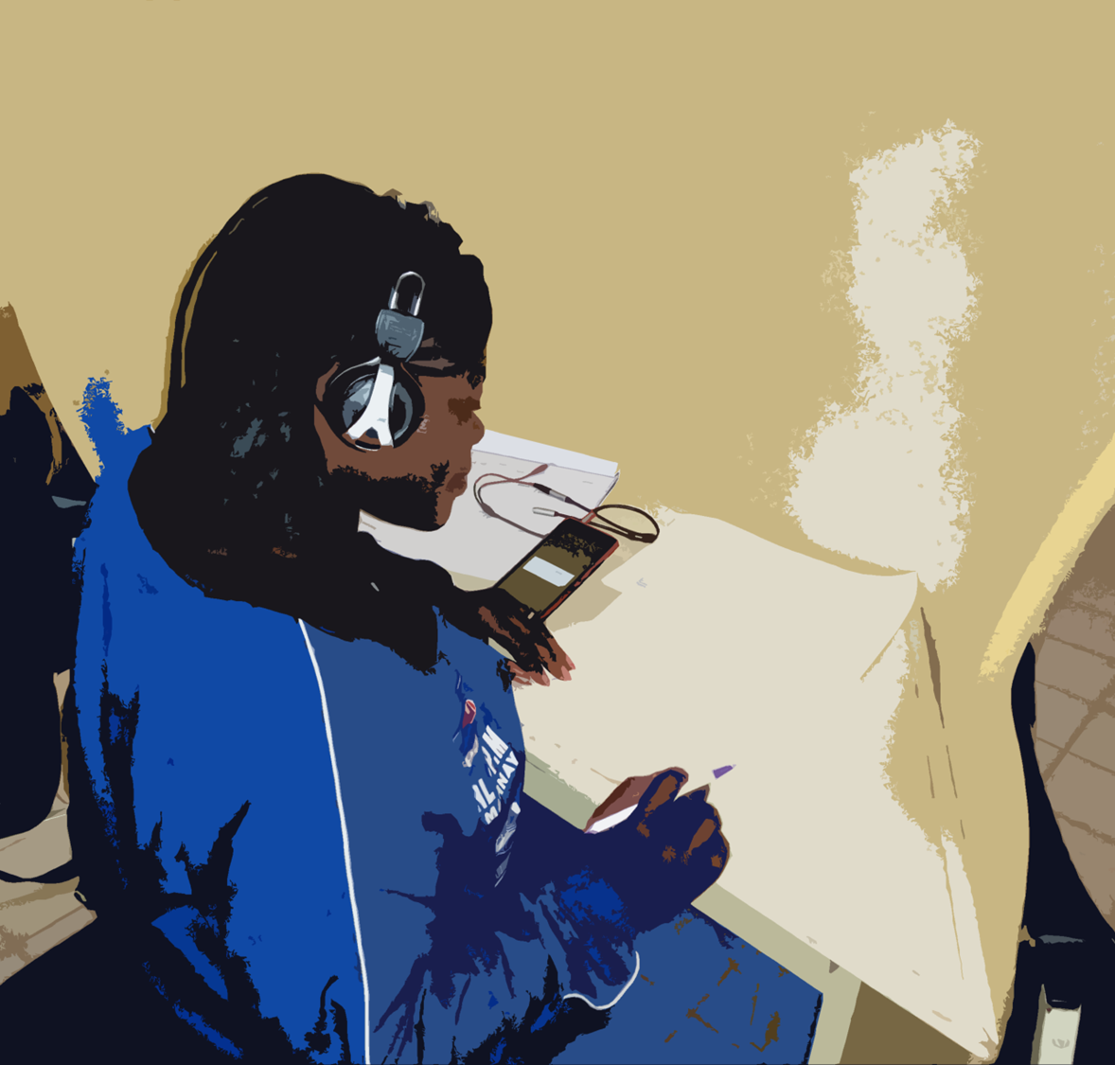
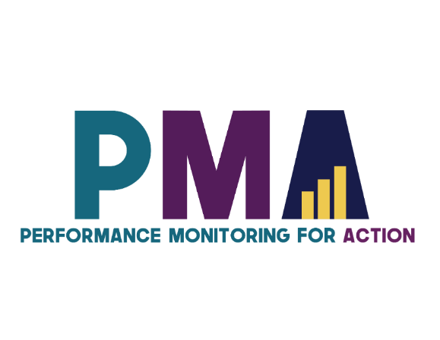
Introduction to Phone Interviewing

Slide 4
In this presentation, we will talk about:
Differences and similarities between phone and face to face interviews
Key components to effective phone interviews:
Strong introduction
Read the questions as written
Control the discussion
Identify and respond to respondent cues
Remain neutral
Probe as needed

Slide 5
Phone Interviews
Face to Face (FTF)
and

Slide 6
In-person / On the phone
What is different between speaking to someone in-person and speaking over the telephone?
In-person
On the phone

Slide 7
Interviewing in-person
Non-verbal cues help with rapport

Slide 8
Interviewing on the phone
You only have words…

Slide 9
Face-to-Face and Phone Interviews:
Differences
Face-to-Face Interview
Phone Interview
Visual cues
Conversation + eye contact
Listening skills & non-visual cues
Conversation
Notes:
FTF Interview
Able to note visual cues, like expressions and body language
Establish rapport through conversation and eye-contact
Phone Interview
Rely on listening skills and ability to interpret paralinguistic cues, like the volume and tone of the respondent’s voice
Establish rapport through conversation
May need to rely on questioning for clarification

Slide 10
Face-to-Face and Phone Interviews
Similarities
Require fidelity to the questions
Require neutrality
Use probing
Require interviewers to guide the discussion
Notes:
Require fidelity to the questions
Read questions as written/translated
Read coded answers if instructed
Do not make assumptions
Use probing
Seek clarification
Get complete answer
Require interviewers to guide the discussion
Skillfully return to the question if respondents digress
Require neutrality
Do not react
Encourage respondent to make the best decision for them

Slide 11
Pop Quiz A!
Name one way face-to-face and phone interviews are DIFFERENT.
Name one way face-to-face and phone interviews are ALIKE
Notes:
Answer Left:
FTF interviews allow interviewers to note visual cues, like body language and facial expressions, while phone interviewers have no visual component and rely solely on listening and paralinguistic cues.
Answer Right:
Both require 1) neutrality, 2) fidelity to questions, 3) probes (as needed), 4) interviewers to guide the discussion

Slide 12
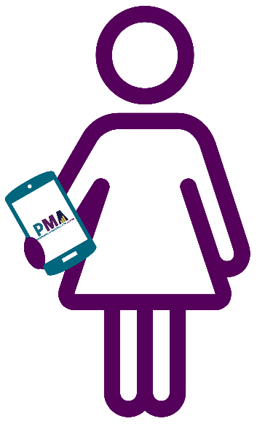
Starting the phone interview
1) Politely greet them
If not respondent: ask to be connected with the respondent
2) Introduce yourself
Full name, title, organisation and project
Remind them that they recently completed FTF interview on women’s health issues
3) Explain reason for call
"I would like to ask you some follow-up questions based on your responses from the last time we talked in person.”

Slide 13
Introducing the study
4) Remind them of the context of the surveys
5) Enquire if this is a good time to talk
If this is not a good time, arrange a date to call back
6) Administer consent
In the language on ODK
Speak slowly and clearly
Allow respondent to follow and ask questions

Slide 14
Additional tips for effective phone interviews
Develop a good rapport from the beginning.
Build trust at the beginning of the interview
Act as though you already know the respondent (because you do!)
Do not lead the respondent to give a specific answer.
Do not give the respondent a way out.
Clarify questions that the respondent does not understand.

Slide 15
Nuances of Phone Interviews (1)
Auditory Cues
Use AUDITORY CUES to your advantage!
Sounds made during speech, which may
be reflective of one’s mental state, focus,
or thoughts
Notes:
Use listening skills to pick-up on auditory cues and use auditory cues to your advantage!
What are auditory cues? Sounds made during speech, which may be reflective of one’s mental state, focus, or thoughts

Slide 16
Auditory Cues - Respondent
Ummmm….
Uh….
1, 2, 3, 4, 5, 6, 7, 8, 9, 10
Should I clarify the question?
Notes:
If respondent says “Ummm” or “Uhhh,” she may be thinking about her response
You should be comfortable with the silence – count to 10 in your head
Then ask if you should clarify the question

Slide 17
Auditory Cues - Respondent
…
1, 2, 3, 4, 5, 6, 7, 8, 9, 10
May I ask the question again?
Notes:
If respondent is silent, she may also be thinking about her response
Again, you should count to 10 in your head
Then offer to ask the question again if she is silent for too long

Slide 18
Auditory Cues - Interviewer
Be explicit. Remember, they can’t see you!
I see.
Neutral responses, not leading
OK
I am listening. You can continue.
Wait for your turn to speak.
Stay silent while she responds.
Notes:
You can and should use auditory cues to your advantage!
Be explicit when interacting with the respondent. Remember, they can’t see you!
Do NOT shake your head to convey a message
Say, “I see”, “OK”, “I am listening, you can continue”
Keep your responses neutral, so as not to appear to be leading her to a particular response
You should wait for your turn to speak, and stay silent while she responds

Slide 19
Pop Quiz B!
True or False:
If the respondent is silent after a question, you should count 10 in your head, and then ask the subsequent question.
Name one or more ways that you can acknowledge a respondent’s answer during a phone interview.
Notes:
Answer Left:
False. If the respondent is silent after a question, you wait for about 10 second, and then gently offer to repeat the question or clarify as needed
Answer Right:
Say, “I see”, “OK”, “I am listening, you can continue”
Keep your responses neutral, so as not to appear to be leading her to a particular response
Maybe you ask the question, say you’re going to pause so they can think (and maybe jot down their answer), and then you announce the answer and the explanation!

Slide 20
Nuances of Phone Interviews (2)
Probing
Direct probes: Ask for more information
Could you elaborate?
I am not sure I understand X. Could you explain?
Could you give me an example of X?
Indirect probes: Acknowledge a response
Ok.
I see.
I am listening. You can continue.

Slide 21
Pop Quiz C!
True or False: If a respondent gives a vague or unclear answer, you should guess which response option goes best with it and proceed to the next question.
Give some examples of direct probes.
Notes:
Answer Left:
Direct: To clarify what was already said in order to understand, complement or categorize.
What do you mean when you say…?
Why do you think…?
Could you explain?
Could you elaborate?
I am not sure I understood
X… Could you explain that to me?
Could you give me an example of X?
Answer Right:
False. You should not try and guess what they were trying to say.
Probe by saying, “What do you mean when you say X?”, “Could you explain?”, “Could you elaborate?”, etc. to get the answer

Slide 22
The missing piece: “Non-response”
I will not answer that.
This is asked of all women surveyed.
Maybe they answer, but I will not.
No response
Notes:
You will encounter situations where the respondent CATEGORICALLY refuses to answer the question
You should reassure confidentiality + remind her that this is asked of all women surveyed.
You should not force her to answer a question. If she again refuses to answer, you should select “No response” as the response.

Slide 23
The missing piece: “Don’t know”
What does she mean by “I don’t know”?
I don’t know.
There is no right or wrong answer.
What if I called back later, and we could continue then?
Don’t know
Notes:
You will encounter situations where the respondent says “I don’t know”
She may say this because:
She may not be sure or is hesitant to give a wrong answer.
- You should reassure her that there is no right or wrong answer.
She wants to end the interview quickly.
- You should subtly confirm if you can call later to complete the interview.
She truly does not know and cannot give an answer.
- You should select “Don’t know” as the response.

Slide 24
Unrelated responses
Ok. So about the question…
Did you know I have 3 cows at home?
Mmmm. Sorry, what? I wasn’t listening. I was…
Today, when I washed my hands here, they ran out of soap! So I went to ask for soap, and they told me to wait. So I waited, but it didn’t come. So then I went to toe store get some more. But at the store…
Be patient and return to the original question
Notes:
Respondents may:
Provide responses unrelated to the question you are asking
Appear like they are not focused on the interview
Give very long answers
In all of these scenarios: Return to the original question WITHOUT interrupting the respondent

Slide 25
Unrelated responses
Do you have soap -
- Soap? Yes. There’s soap.
Might you permit me to read the entire question before answering?
Notes:
If the participant answers before you have finished asking the full question:
Ask them to let you read the entire question before answering.

Slide 26
Pop Quiz D!
What do you do if the respondent says she “does not know”, the response to a particular question?
True or False: You may interrupt the respondent if her response is unrelated to the survey question.
True or False: If a respondent acts like she wants to finish the interview, you should quickly ask her the remaining survey questions.
Notes:
Answer Left: First, reassure her that there is no right or wrong answer to any question, and that her response should be as it is applicable to her own life. If she persists in saying she does not know, she may truly not know the response, and that is a valid response. Lastly, if she appears to be in a hurry, and wants to finish the interview, subtly suggest to continue the interview at a later time.
Answer Top Right: False. If the respondent digresses from the expected response, allow her to complete her response, gently rein her back into the survey, and remind her you would be happy to touch upon these points after finishing the survey.
Answer Bottom Right: False. Ask her if she would like to reschedule the interview for another time so that she can thoughtfully consider the remaining questions.

Slide 27
Other situations
Doij. Hhiucw. uh ihd… !!!
???
Might we reschedule the interview at another time convenient to you?
Notes:
If there is noise in the background, and you are unable to hear the respondent clearly:
Gently suggest that you would like to reschedule the interview at another time convenient to them.
If someone other than the respondent answers the phone and gives you another number:
Note down the phone number in ODK and make a subsequent call attempt to reach the respondent.

Slide 28
Pop Quiz E!
Which of these is a good way to probe on the phone?
“What do you mean when you say…?”
“I do not think that is correct, please answer again.”
Silence
“Could you give me an example of X?”
“I suppose you mean that … Is that right?”
“I am not sure I understood.”
Notes:
Correct:
What do you mean when you say…?
Silence
Could you give me an example of X?
I am not sure I understood
Incorrect:
I suppose you mean that… Is that right?
I do no think that is correct, please answer again.

Slide 29
Calling from a home ‘office’
Identify a specific place if possible
Minimize background noise
Check phone signal
Notes:
#countryspecific – This slide is designed to teach on important reminders for placing phone calls from home. If your team is organizing a call center instead of having REs place phone calls from home, DELETE THIS SLIDE.

Slide 30
Image sources:
Slides 4, 5, 11, 14, 15, 16, 17, 21, 22, 23, 24, 26, & 28: Microsoft 365 stock images
Slide 6: Smiling Black woman with her thumbs up by Carlos David from Noun Project (CC BY-NC-ND 2.0)
Slide 7: Text Miscommunication by John Salzarulo from Noun Project (CC BY 3.0)
Slide 7: Telephones from Microsoft 365 stock images
Slide 19: Snowball Fight by Claire Jones from Noun Project (CC BY 3.0)

